Slide 1

Laravel t01 Create Laravel Project with Laragon
http://fstm.kuis.edu.my/blog/laravel

Slide 2
Module Outcome
Day 1
Create Laravel Project
Working with Database.
Working with Model
Working with Controllers
Working with Views
What will be needed
Laragon
phpMyAdmin
VS Code

Slide 3
routes/web.php
app/Http/Controllers
app/
resources/views
Notes:
In Slide Show mode, select the arrows to visit links.

Slide 4
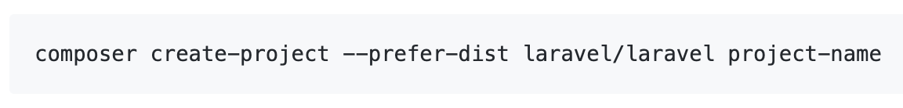
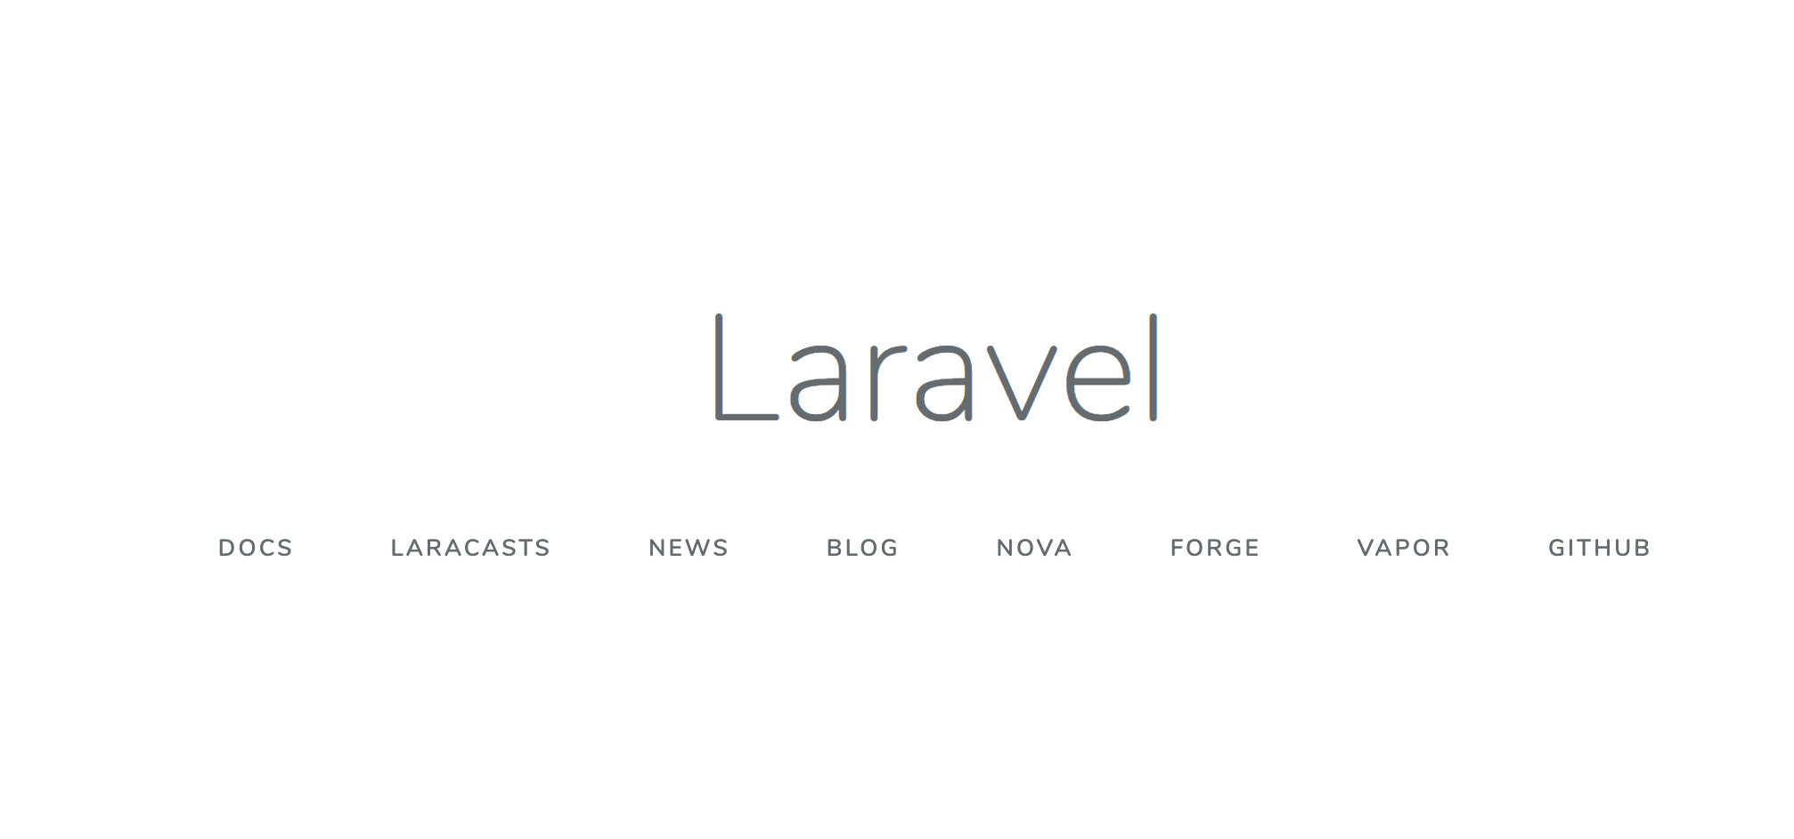
Create Laravel First Project
Install Laravel by issuing the Composer create-project command in your terminal

Slide 5
laragon.org
With Laragon?
Never been EASIER.

Slide 6
Laragon
What is Laragon? Laragon is a portable, isolated, fast & powerful universal development environment for PHP, Node.js, Python, Java, Go, Ruby. It is fast, lightweight, easy-to-use and easy-to-extend. Why Laragon? Laragon is great for building and managing modern web applications. It is focused on performance - designed around stability, simplicity, flexibility and freedom. Laragon improves web development. Developers all over the world are using Laragon to make apps quickly and easily. It is used by thousands of developers with loves. You can check out the Testimonials to see how users think of Laragon and it’s features page for more details.

Slide 7
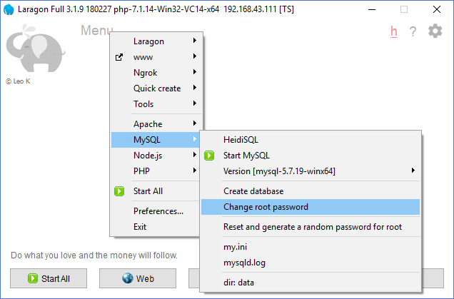
Change DB root password

Slide 8
Laravel t02 Adding Authentication in Laravel Project
http://fstm.kuis.edu.my/blog/laravel

Slide 9
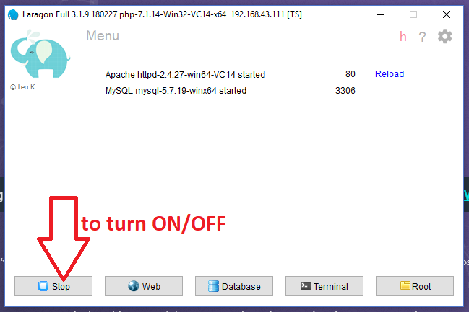
Turn On Laragon
By default Laragon will served port 80 for Apache and port 3306 for DB

Slide 10
Create Project

Slide 11
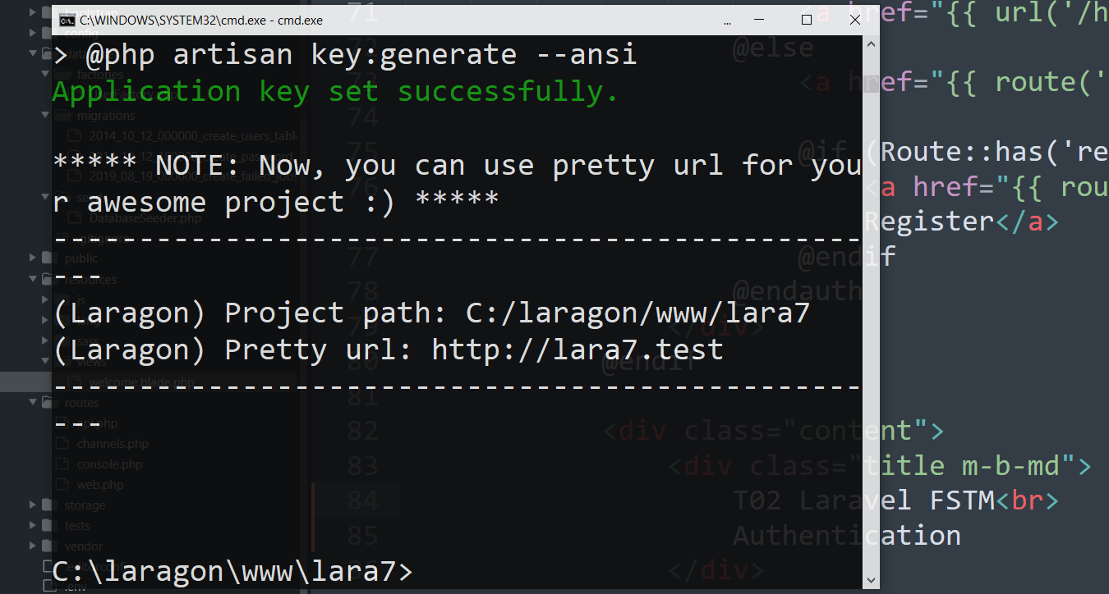
Laravel project with Pretty URL
Test the Pretty url in browser

Slide 12
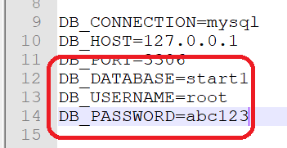
Update DB credentials in .env

Slide 13
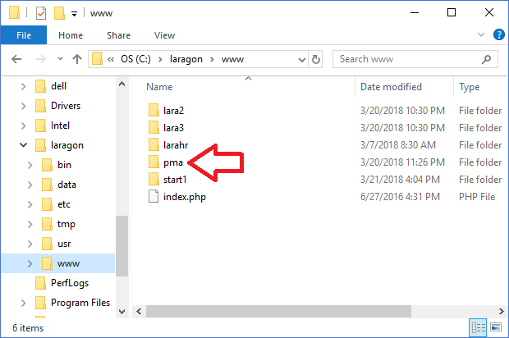
Download and install phpmyadmin.Net
Try access
http://localhost/pma

Slide 14
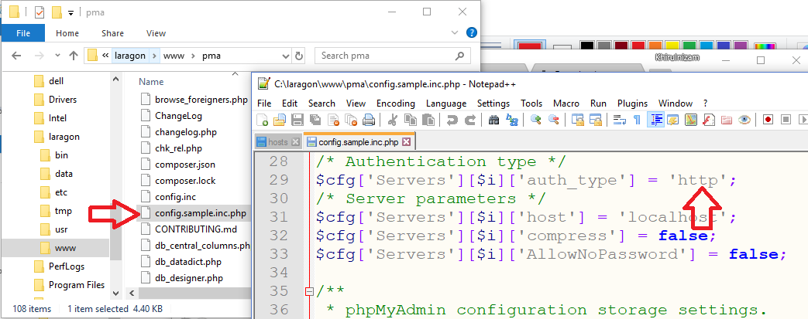
Phpmyadmin config.inc

Slide 15
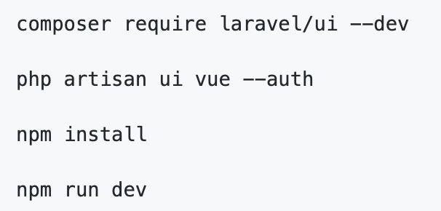
Authentication Module
Laravel makes implementing authentication very simple. In fact, almost everything is configured for you out of the box.

Slide 16
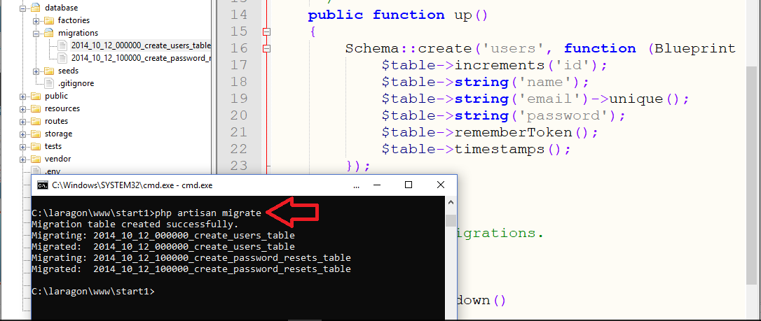
Authentication Module

Slide 17
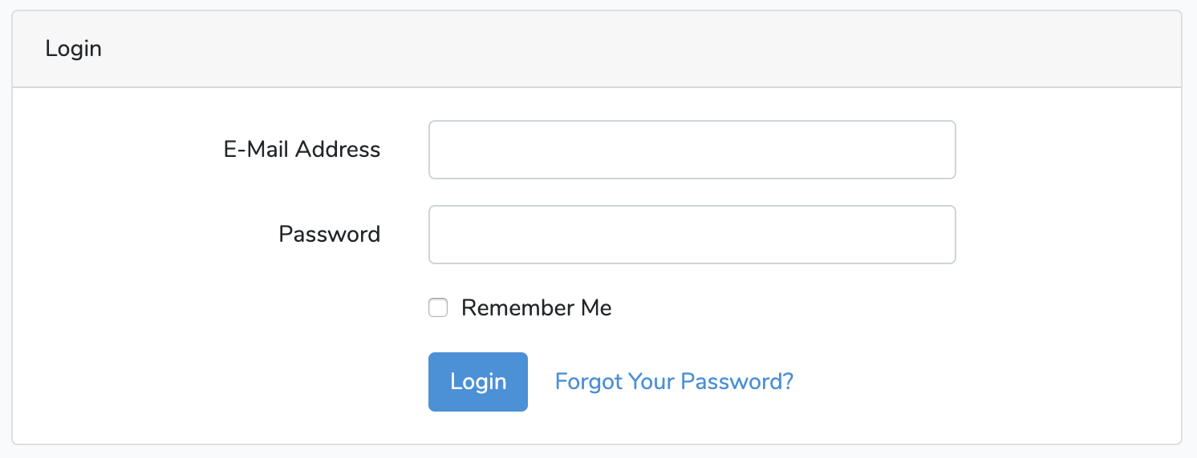
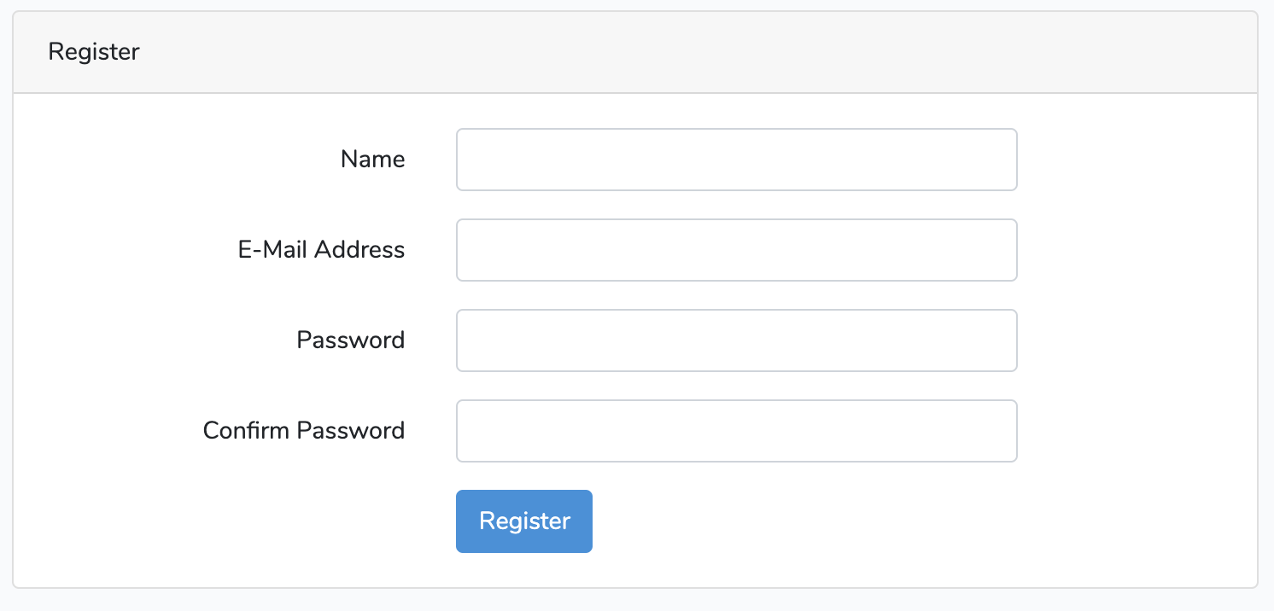
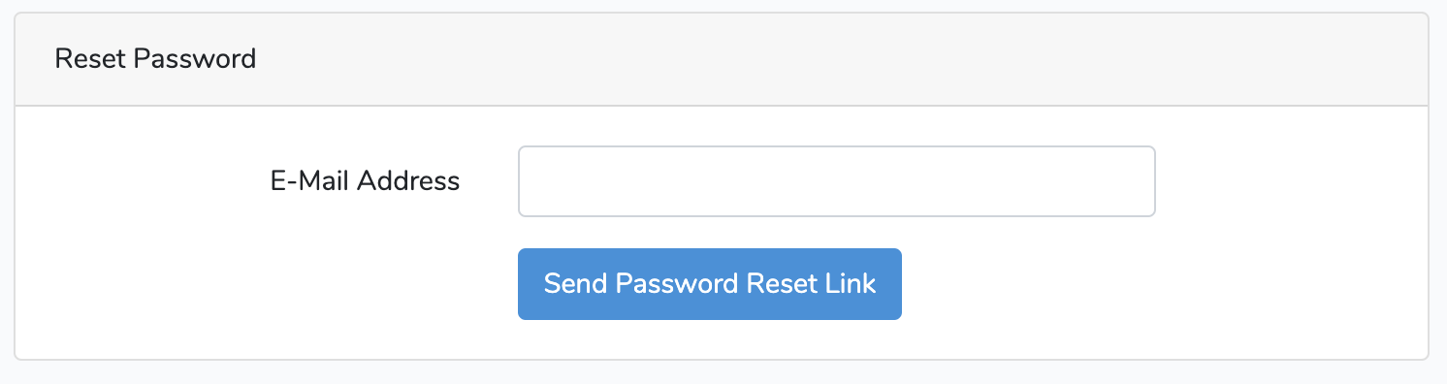

Slide 18
Laravel t03 Database Migration, Seeder & Factory in Laravel Project
http://fstm.kuis.edu.my/blog/laravel

Slide 19
routes/web.php
app/Http/Controllers
app/
resources/views
Notes:
In Slide Show mode, select the arrows to visit links.

Slide 20
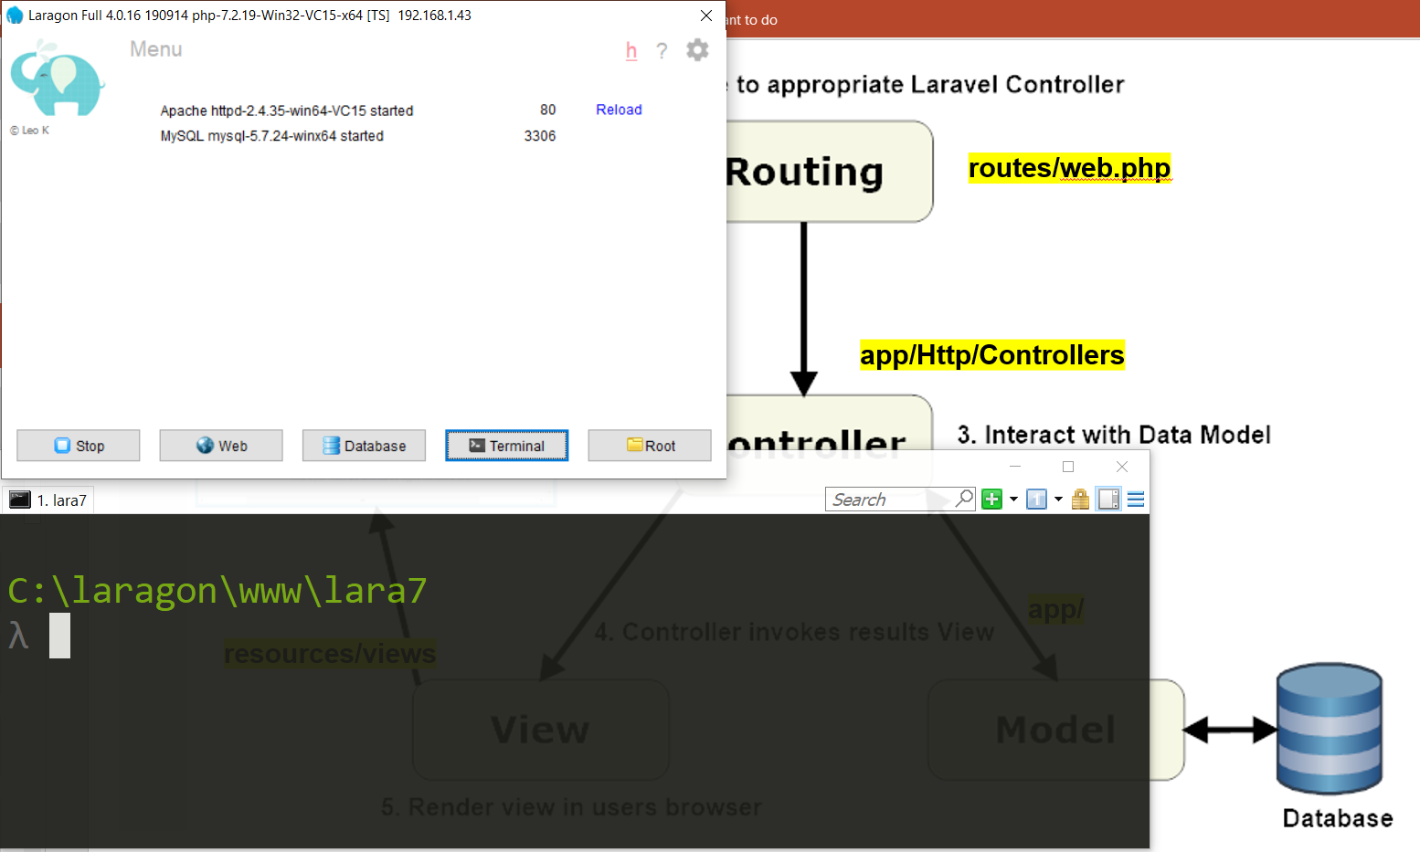

Slide 21
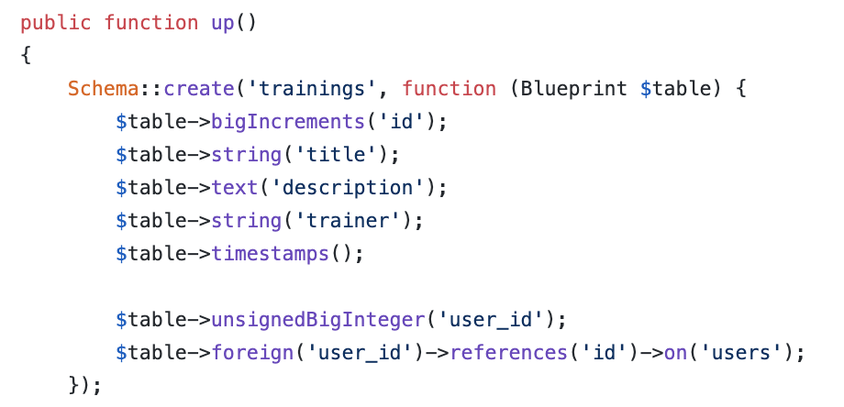
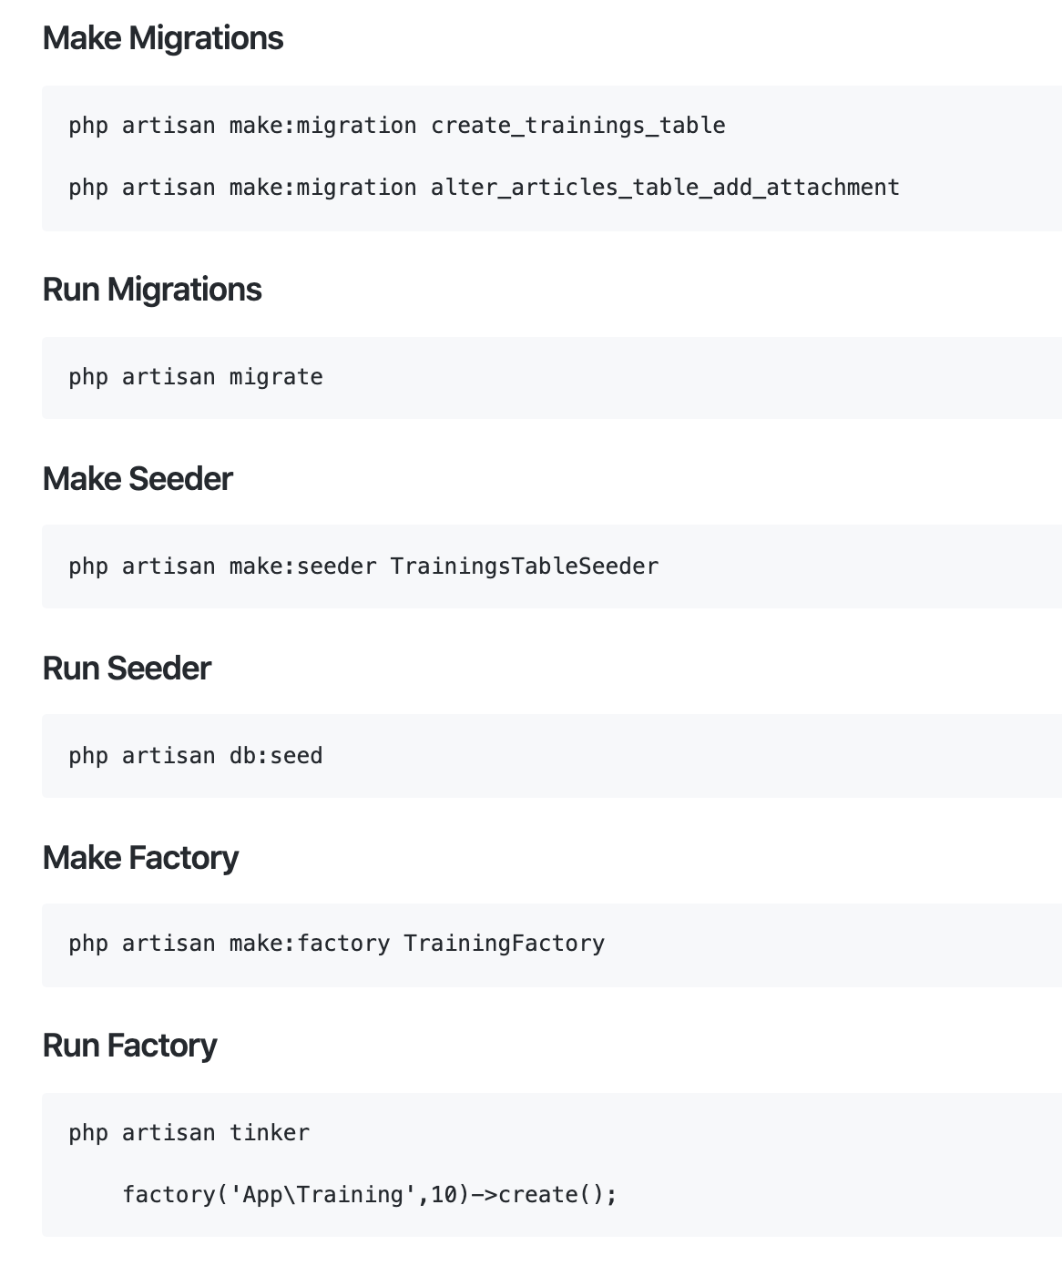
Working with Database
Database Migrations
Migrations are like version control for your database.

Slide 22
php artisan migrate

Slide 23
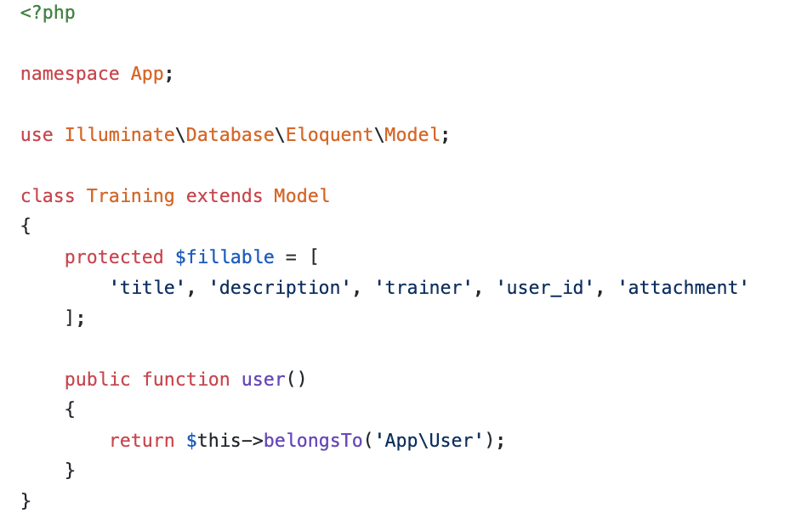
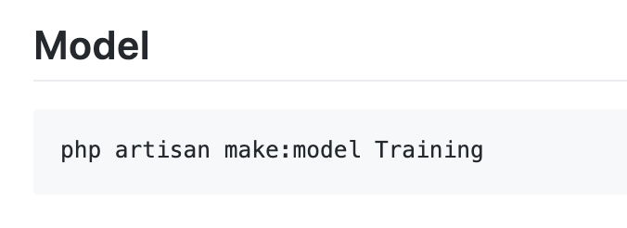
Model
Models typically live in the app directory.
All Eloquent models extend Illuminate\Database\Eloquent\Model class.

Slide 24
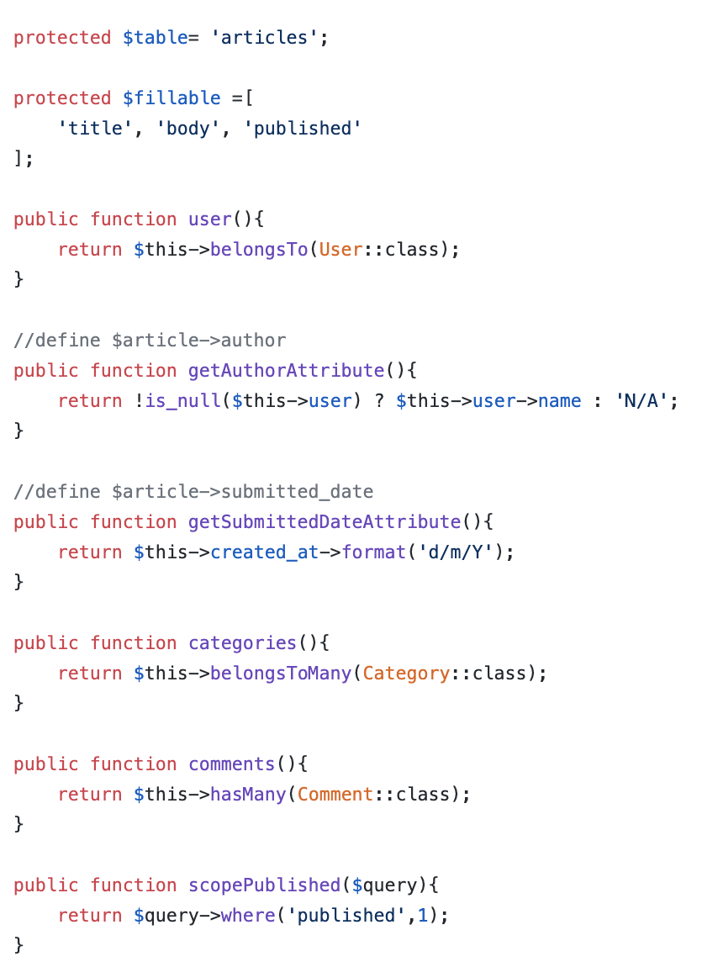
Model
Model used to define fillable attributes.
Model also can be used to define relationship
Model also can be used to to specify custom table.
Model also can be used to define mutator
Model also can be used to define local scope

Slide 25
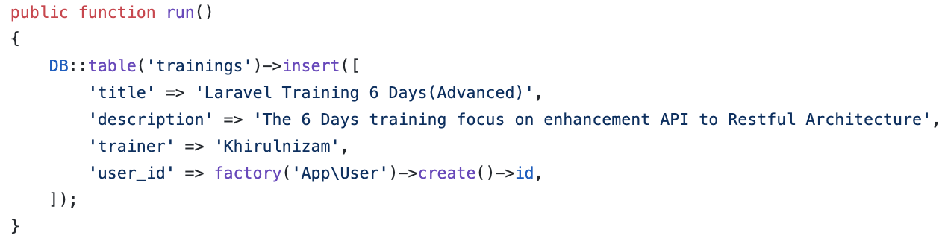
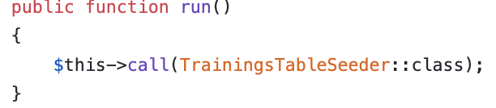
Working with Database
On database/seeds/TrainingsTableSeeder.php
Database Seeds
Laravel includes a simple method of seeding your database with test data using seed classes.
On database/seeds/DatabaseSeeder.php

Slide 26
Working with Database : run seeder

Slide 27
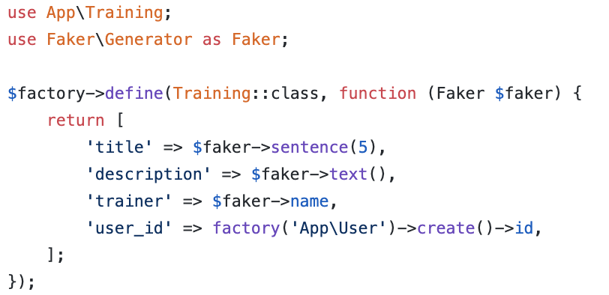
Working with Database
Database Factories
Laravel has a feature called model factories that allows you to build fake data for your models.

Slide 28
How to create and run migrations, seeder and factory?
Here are the example.

Slide 29
Laravel t04 Controller
http://fstm.kuis.edu.my/blog/laravel

Slide 30
routes/web.php
app/Http/Controllers
app/
resources/views
Notes:
In Slide Show mode, select the arrows to visit links.

Slide 31
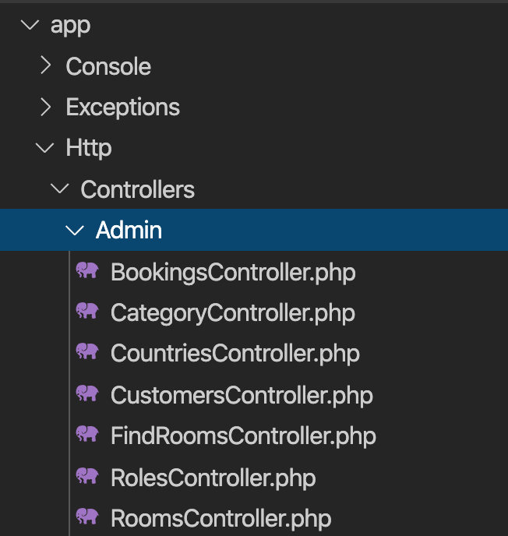
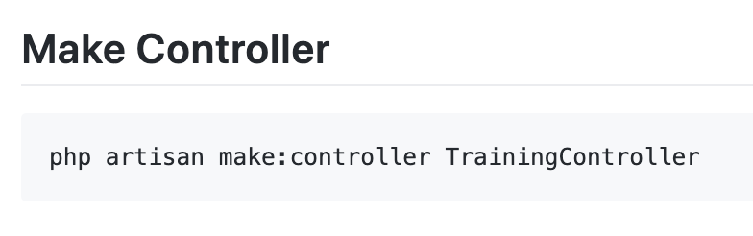
Controller
Instead of defining all of your request handling logic as Closures in route files, you may wish to organize this behavior using Controller classes.
Controllers can group related request handling logic into a single class.
Controllers are stored in the.app/Http/Controllers directory.

Slide 32
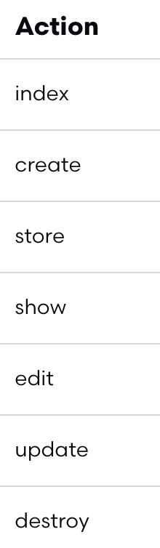
Controller
7 method in controllers

Slide 33
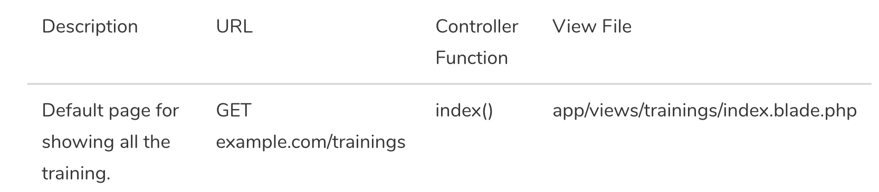
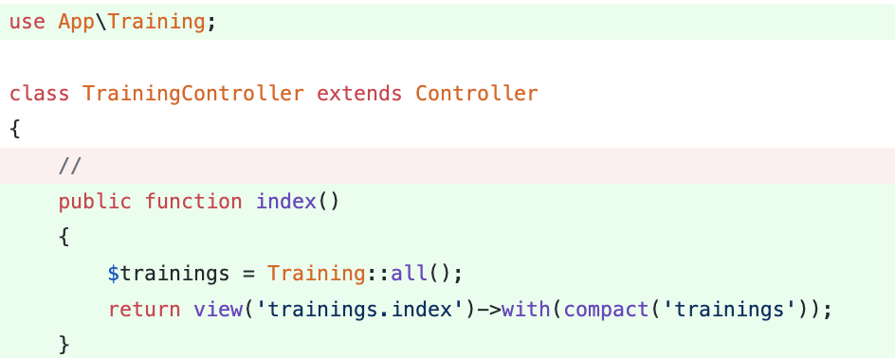
Controller - Index

Slide 34
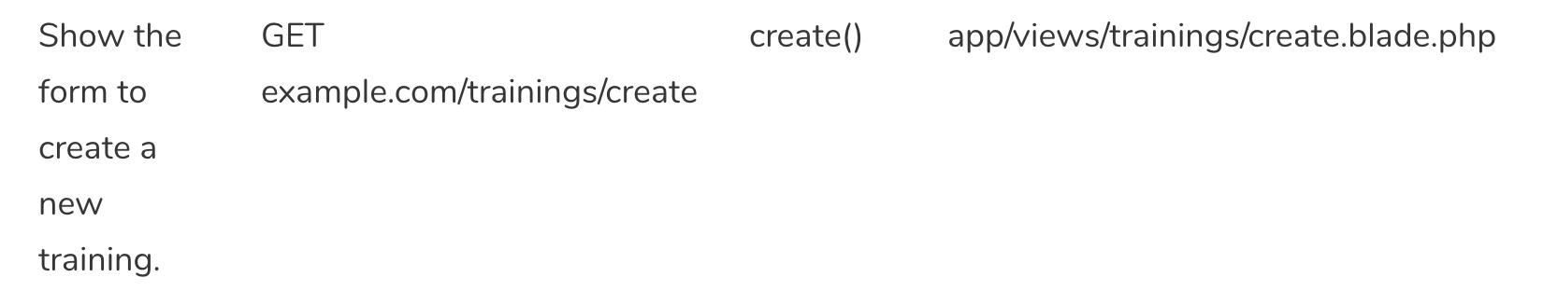
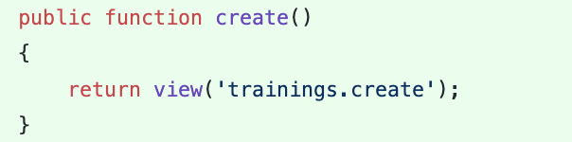
Controller - Create

Slide 35
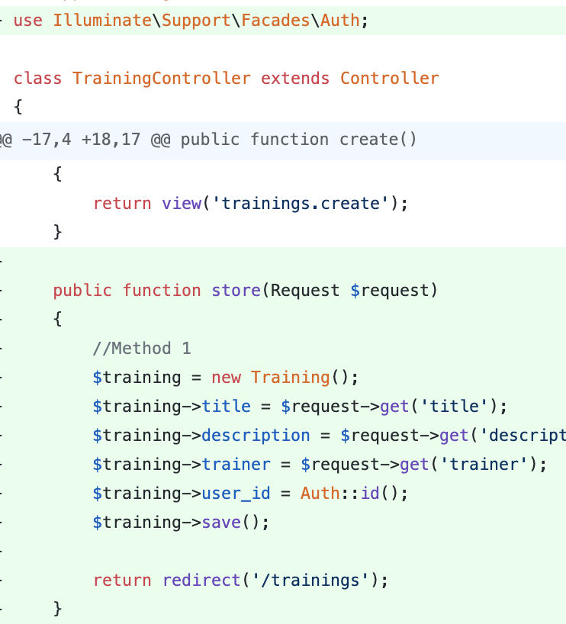
Controller - Store

Slide 36
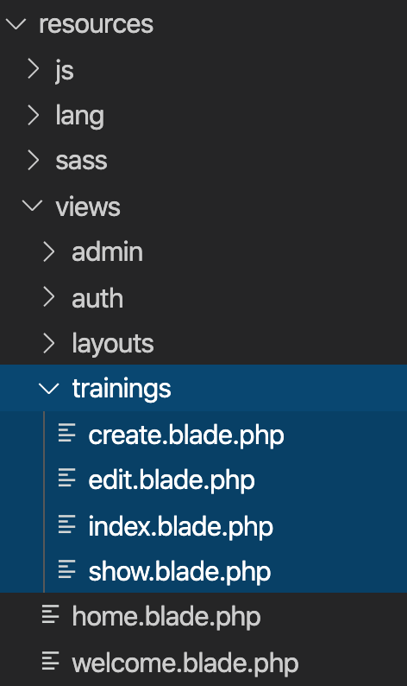
Views
Views contain the HTML served by your application and separate your controller / application logic from your presentation logic.
Views are stored in the resources/views directory

Slide 37
Views
Views are stored in the resources/views directory
Go to resources/views
Create training folder
Inside training folder, create:
create.blade.php
index.blade.php

Slide 38
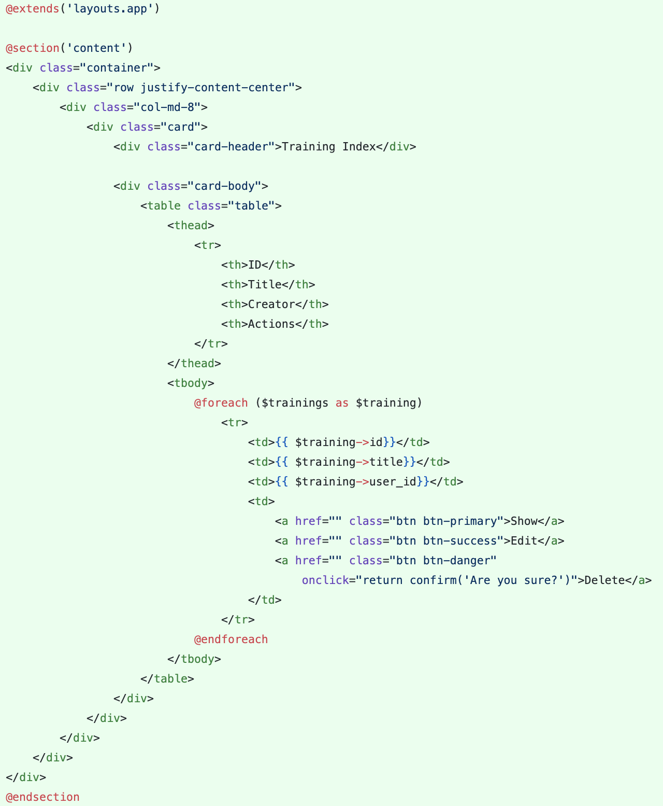
Views – Index View
Views are stored in the resources/views directory
Go to resources/views/trainings/index.blade.php

Slide 39
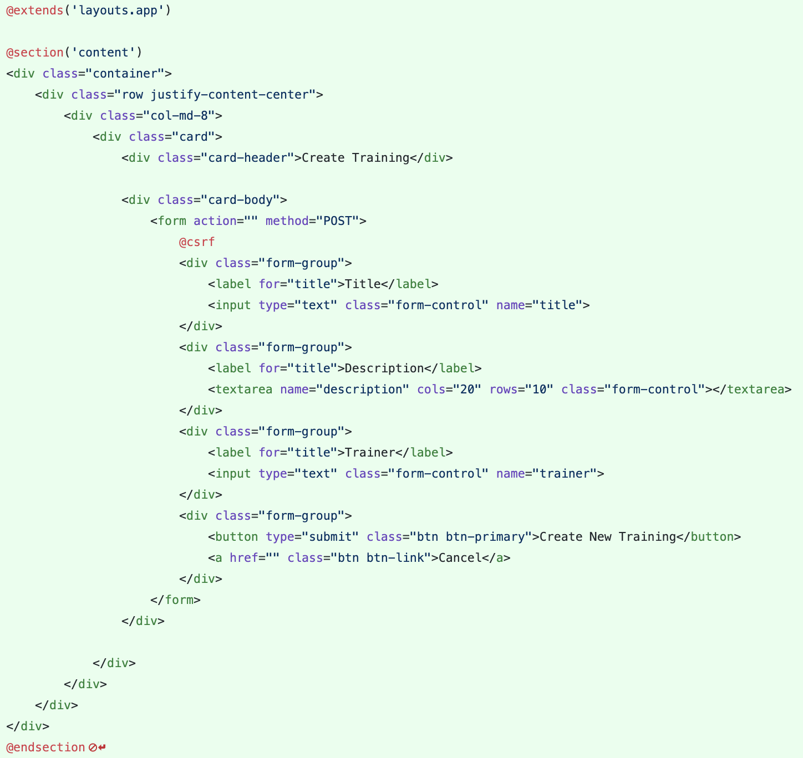
Views – Create View
Views are stored in the resources/views directory
Go to resources/views/trainings/create.blade.php

Slide 40
Laravel t05 Routing
http://fstm.kuis.edu.my/blog/laravel

Slide 41
routes/web.php
app/Http/Controllers
app/
resources/views
Notes:
In Slide Show mode, select the arrows to visit links.

Slide 42
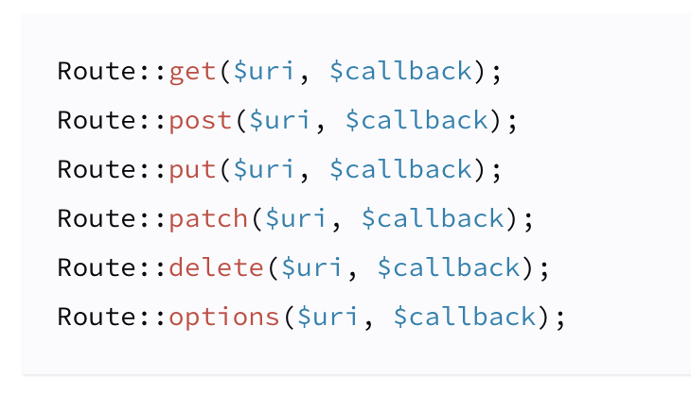
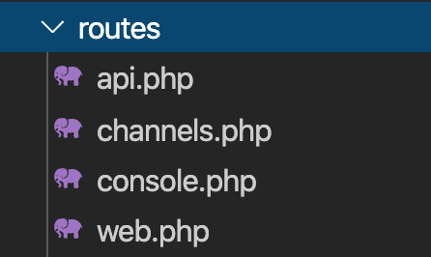
Routing
All Laravel routes are defined in your route files, which are located in the routes directory.
https://laravel.com/docs/6.x/routing.

Slide 43
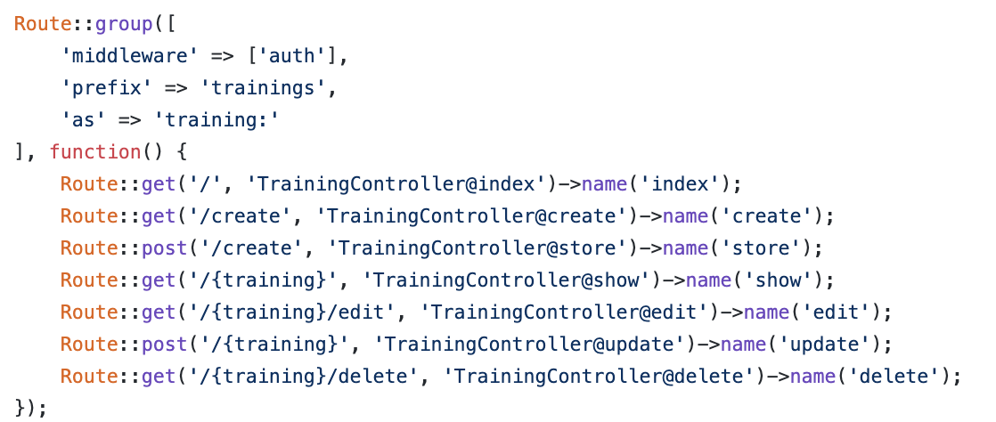
Simple Routing
All Laravel routes are defined in your route files, which are located in the routes directory.
https://laravel.com/docs/6.x/routing.

Slide 44
Routing – Group and Named Route
All Laravel routes are defined in your route files, which are located in the routes directory.
https://laravel.com/docs/6.x/routing.

Slide 45
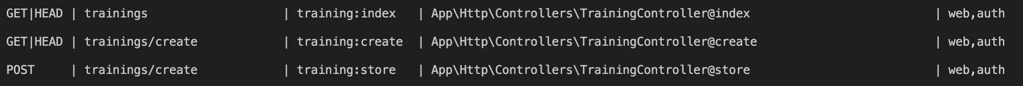
Routing – Group and Named Route
php artisan route:list
https://laravel.com/docs/6.x/routing.

Slide 46
Hacks
Creating Index - https://github.com/samtarmizi/laravel-spr/commit/1c925853f61da081f0e3ce298e58a4a423b66040
Creating Create - https://github.com/samtarmizi/laravel-spr/commit/7a5b5f3b643bcb8a265af3bb9f4e94e3aef95aa1
Creating Store - https://github.com/samtarmizi/laravel-spr/commit/2513b55c65bc4d27afa5004144ee2c7d41b3cbd7

